Slide 1
Software Process Model
Matakuliah Rekayasa Perangkat Lunak (CS215) – Gasal 2015/2016
Magister Ilmu Komputer - Universitas Budi Luhur
Achmad Solichin, S.Kom, M.T.I (achmatim@gmail.com)

Slide 2
Overview
General Principles of Software Engineering
Software Process
Software Process Models
Selecting the Software Process Model.

Slide 3
Hooker’s General Principles of SE
#1. The Reason It All Exists
A software system exists for one reason: to provide value to its users. All decisions should be made with this in mind. Before specifying a system requirement, before noting a piece of system functionality, before determining the hardware platforms or development processes, ask yourself questions such as: “Does this add real value to the system?” If the answer is “no,” don’t do it. All other principles support this one.
#2. KISS (Keep It Simple, Stupid!)
Software design is not a haphazard process. There are many factors to consider in any design effort. All design should be as simple as possible, but no simpler. This facilitates having a more easily understood and easily maintained system.
[Pressman, 2010]

Slide 4
Hooker’s General Principles of SE
#3. Maintain the Vision
A clear vision is essential to the success of a software project. Without one, a project almost unfailingly ends up being “of two [or more] minds” about itself. Having an empowered architect who can hold the vision and enforce compliance helps ensure a very successful software project.
#4. What You Produce, Others Will Consume
Seldom is an industrial-strength software system constructed and used in a vacuum. In some way or other, someone else will use, maintain, document, or otherwise depend on being able to understand your system. So, always specify, design, and implement knowing someone else will have to understand what you are doing.
[Pressman, 2010]

Slide 5
Hooker’s General Principles of SE
#5. Be Open to the Future
The systems must be ready to adapt to any changes of computing environment in the future.
#6. Plan Ahead for Reuse
Reuse saves time and effort. Planning ahead for reuse reduces the cost and increases the value of both the reusable components and the systems into which they are incorporated.
#7. Think!
Placing clear, complete thought before action almost always produces better results. When you think about something, you are more likely to do it right.
[Pressman, 2010]

Slide 6
Software Process
A structured set of activities required to develop a software system.
Many different software processes but all involve:
Specification – defining what the system should do;
Design and implementation – defining the organization of the system and implementing the system;
Validation – checking that it does what the customer wants;
Evolution – changing the system in response to changing customer needs.
A software process model is an abstract representation of a process. It presents a description of a process from some particular perspective
[Sommerville, 2011]

Slide 7
Software Process Descriptions
When we describe and discuss processes, we usually talk about the activities in these processes such as specifying a data model, designing a user interface, etc. and the ordering of these activities.
Process descriptions may also include:
Products, which are the outcomes of a process activity;
Roles, which reflect the responsibilities of the people involved in the process;
Pre- and post-conditions, which are statements that are true before and after a process activity has been enacted or a product produced.
[Sommerville, 2011]

Slide 8
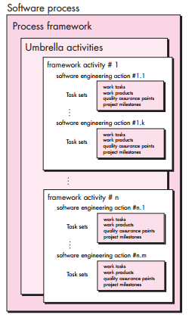
Generic Software Process Model
A process was defined as a collection of work activities, actions, and tasks that are performed when some work product is to be created.
Generic process framework for software engineering defines 5 framework activities:
Communication
Planning
Modeling
Construction
Deployment.
[Pressman, 2010]

Slide 9
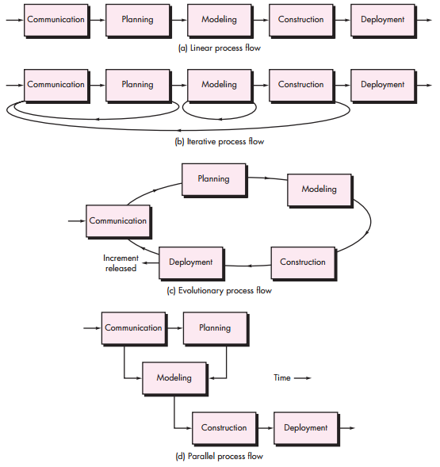
Process Flow
[Pressman, 2010]

Slide 10
Task Set
A task set defines the actual work to be done to accomplish the objectives of a software engineering action.
For a small, relatively simple project, the task set for requirements gathering might look like this:
Make a list of stakeholders for the project.
Invite all stakeholders to an informal meeting.
Ask each stakeholder to make a list of features and functions required.
Discuss requirements and build a final list.
Prioritize requirements.
Note areas of uncertainty
[Pressman, 2010]

Slide 11
Task Set
For a larger, more complex software project:
Make a list of stakeholders for the project.
Interview each stakeholder separately to determine overall wants and needs.
Build a preliminary list of functions and features based on stakeholder input.
Schedule a series of facilitated application specification meetings.
Conduct meetings.
Produce informal user scenarios as part of each meeting.
Refine user scenarios based on stakeholder feedback.
Build a revised list of stakeholder requirements.
Use quality function deployment techniques to prioritize requirements.
Package requirements so that they can be delivered incrementally.
Note constraints and restrictions that will be placed on the system.
Discuss methods for validating the system.
[Pressman, 2010]

Slide 12
Take a break….
https://youtu.be/PA54HWLZ2e4

Slide 13
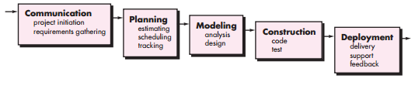
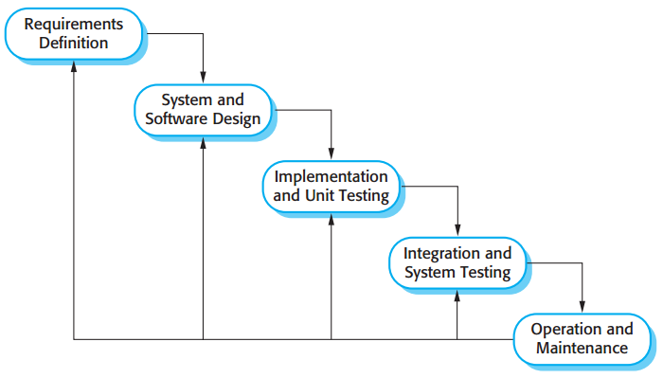
The Waterfall Model
[Pressman, 2010]
[Sommerville, 2011]

Slide 14
Waterfall Model Problems
Inflexible partitioning of the project into distinct stages makes it difficult to respond to changing customer requirements.
Therefore, this model is only appropriate when the requirements are well-understood and changes will be fairly limited during the design process.
Few business systems have stable requirements.
The waterfall model is mostly used for large systems engineering projects where a system is developed at several sites.
In those circumstances, the plan-driven nature of the waterfall model helps coordinate the work.
[Sommerville, 2011]

Slide 15
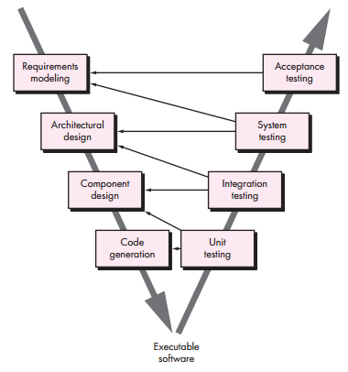
V-Model
[Pressman, 2010]

Slide 16
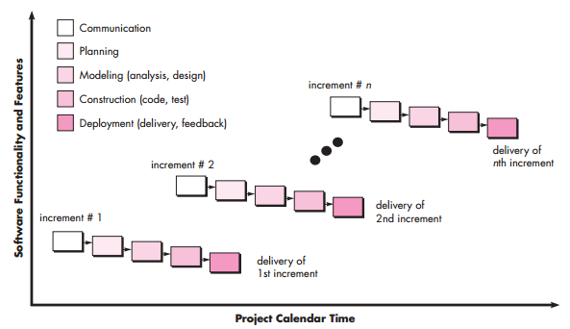
The Incremental Model
[Pressman, 2010]

Slide 17
The Incremental Model Benefits
The cost of accommodating changing customer requirements is reduced. The amount of analysis and documentation that has to be redone is much less than is required with the waterfall model.
It is easier to get customer feedback on the development work that has been done. Customers can comment on demonstrations of the software and see how much has been implemented.
More rapid delivery and deployment of useful software to the customer is possible. Customers are able to use and gain value from the software earlier than is possible with a waterfall process.
[Sommerville, 2011]

Slide 18
The Incremental Model Problems
The process is not visible.
Managers need regular deliverables to measure progress. If systems are developed quickly, it is not cost-effective to produce documents that reflect every version of the system.
System structure tends to degrade as new increments are added.
Unless time and money is spent on refactoring to improve the software, regular change tends to corrupt its structure. Incorporating further software changes becomes increasingly difficult and costly.
The problems of incremental development become particularly acute for large, complex, long-lifetime systems, where different teams develop different parts of the system.
[Sommerville, 2011]

Slide 19
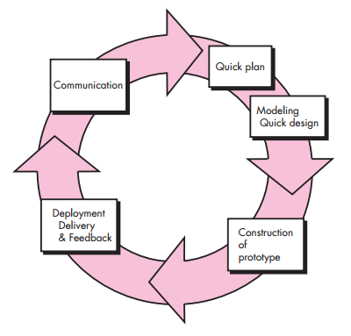
Evolutionary Model: Prototyping
[Pressman, 2010]

Slide 20
The Prototyping Benefits
Improved system usability.
A closer match to users’ real needs.
Improved design quality.
Improved maintainability.
Reduced development effort.
[Sommerville, 2011]

Slide 21
The Prototyping Problems
Stakeholders see what appears to be a working version of the software, unaware that the prototype is held together haphazardly, unaware that in the rush to get it working you haven’t considered overall software quality or long-term maintainability. When informed that the product must be rebuilt so that high levels of quality can be maintained, stakeholders cry foul and demand that “a few fixes” be applied to make the prototype a working product. Too often, software development management relents.
As a software engineer, you often make implementation compromises in order to get a prototype working quickly. An inappropriate operating system or programming language may be used simply because it is available and known; an inefficient algorithm may be implemented simply to demonstrate capability. After a time, you may become comfortable with these choices and forget all the reasons why they were inappropriate. The less-than-ideal choice has now become an integral part of the system
[Pressman, 2010]

Slide 22
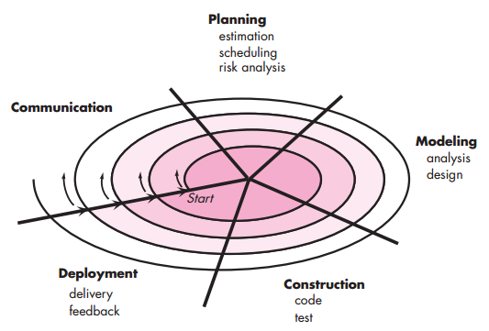
Evolutionary Model: The Spiral
[Pressman, 2010]

Slide 23
Evolutionary Model: The Spiral
A spiral model is divided into a set of framework activities defined by the software engineering team.
The software team performs activities that are implied by a circuit around the spiral in a clockwise direction, beginning at the center.
Anchor point milestones—a combination of work products and conditions that are attained along the path of the spiral—are noted for each evolutionary pass.
The first circuit around the spiral might result in the development of a product specification; subsequent passes around the spiral might be used to develop a prototype and then progressively more sophisticated versions of the software.
Cost and schedule are adjusted based on feedback derived from the customer after delivery.
[Pressman, 2010]

Slide 24
Evolutionary Model: The Spiral
Each loop in the spiral is split into four sectors:
Objective setting. Specific objectives for that phase of the project are defined
Risk assessment and reduction. For each of the identified project risks, a detailed analysis is carried out.
Development and validation. After risk evaluation, a development model for the system is chosen.
Planning. The project is reviewed and a decision made whether to continue with a further loop of the spiral.
[Sommerville, 2011]

Slide 25
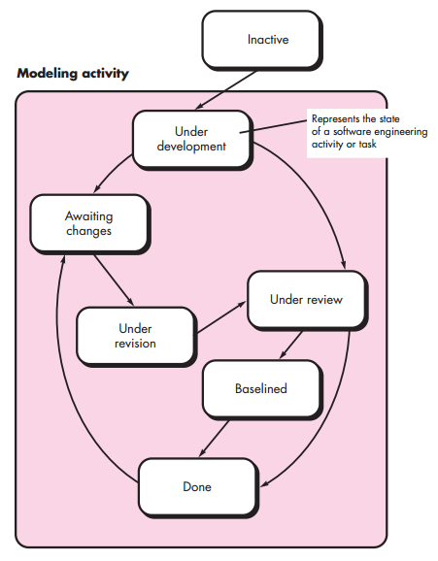
Evolutionary Model: Concurrent
[Pressman, 2010]

Slide 26
Take a break again…
https://youtu.be/-79uIRQiAFM

Slide 27
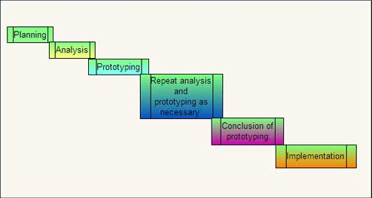
Rapid Application Development (RAD)

Slide 28
Rapid Application Development (RAD)
Planning: In this phase, the tasks and activities are planned. The deliverables produced from this phase are project definition, project management procedures, and a work plan.
Analysis: The requirements are gathered at a high level instead of at the precise set of detailed requirements level. Incase the user changes the requirements, RAD allows changing these requirements over a period of time. This phase determines plans for testing, training and implementation processes.
Prototyping: The requirements defined in the analysis phase are used to develop a prototype of the application. A final system is then developed with the help of the prototype.
Repeat analysis and prototyping as necessary: When the prototype is developed, it is sent to the user for evaluating its functioning. After the modified requirements are available, the prototype is updated according to the new set of requirements and is again sent to the user for analysis.
Conclusion of prototyping: As a prototype is an iterative process, the project manager and user agree on a fixed number of processes. Ideally, three iterations are considered. After the third iteration, additional tasks for developing the software are performed and then tested. Last of all, the tested software is implemented.
Implementation: The developed software, which is fully functioning, is deployed at the user's end.

Slide 29
Rapid Application Development (RAD)
Advantages
Disadvantages
Deliverables are easier to transfer as high-level abstractions, scripts, and intermediate codes are used.
Provides greater flexibility as redesign is done according to the developer.
Results in reduction of manual coding due to code generators and code reuse.
Encourages user involvement.
Possibility of lesser defects due to prototyping in nature.
Useful for only larger projects.
RAD projects fail if there is no commitment by the developers or the users to get software completed on time.
Not appropriate when technical risks are high. This occurs when the new application utilizes new technology or when new software requires a high degree of interoperability with existing system.
As the interests of users and developers can diverge from single iteration to next, requirements may not converge in RAD model.

Slide 30
Specialized Process Model
Component based development—the process to apply when reuse is a development objective
Formal methods—emphasizes the mathematical specification of requirements
Aspect-Oriented Software Development—provides a process and methodological approach for defining, specifying, designing, and constructing aspects
Unified Process—a “use-case driven, architecture-centric, iterative and incremental” software process closely aligned with the Unified Modeling Language (UML). Proposed by Ivar Jacobson, Grady Booch, and James Rumbaugh at the early 1990-s
[Pressman, 2010]

Slide 31
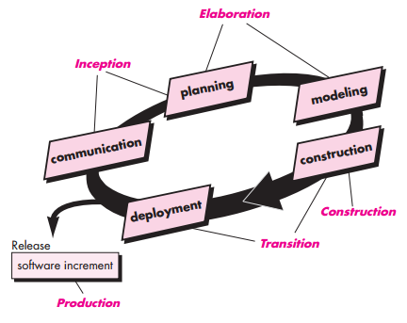
The Unified Process
[Pressman, 2010]

Slide 32
The Unified Process Phases
Inception. The goal of the inception phase is to establish a business case for the system. You should identify all external entities (people and systems) that will interact with the system and define these interactions. You then use this information to assess the contribution that the system makes to the business. If this contribution is minor, then the project may be cancelled after this phase.
Elaboration. The goals of the elaboration phase are to develop an understanding of the problem domain, establish an architectural framework for the system, develop the project plan, and identify key project risks. On completion of this phase you should have a requirements model for the system, which may be a set of UML use-cases, an architectural description, and a development plan for the software.
[Sommerville, 2011]

Slide 33
The Unified Process Phases
Construction. The construction phase involves system design, programming, and testing. Parts of the system are developed in parallel and integrated during this phase. On completion of this phase, you should have a working software system and associated documentation that is ready for delivery to users.
Transition. The final phase of the RUP is concerned with moving the system from the development community to the user community and making it work in a real environment. This is something that is ignored in most software process models but is, in fact, an expensive and sometimes problematic activity. On completion of this phase, you should have a documented software system that is working correctly in its operational environment.
[Sommerville, 2011]

Slide 34
Static Workflow of Rational Unified Process
Workflow | Description
Business modelling | The business processes are modelled using business use cases.
Requirements | Actors who interact with the system are identified and use cases are developed to model the system requirements.
Analysis and design | A design model is created and documented using architectural models, component models, object models and sequence models.
Implementation | The components in the system are implemented and structured into implementation sub-systems. Automatic code generation from design models helps accelerate this process.
[Sommerville, 2011]

Slide 35
Static Workflow of Rational Unified Process
Workflow | Description
Testing | Testing is an iterative process that is carried out in conjunction with implementation. System testing follows the completion of the implementation.
Deployment | A product release is created, distributed to users and installed in their workplace.
Configuration and change management | This supporting workflow managed changes to the system
Project management | This supporting workflow manages the system development
Environment | This workflow is concerned with making appropriate software tools available to the software development team.
[Sommerville, 2011]

Slide 36
Best Practices of Rational Unified Process
Develop software iteratively. Plan increments based on customer priorities and deliver highest priority increments first.
Manage requirements. Explicitly document customer requirements and keep track of changes to these requirements.
Use component-based architectures. Organize the system architecture as a set of reusable components.
Visually model software. Use graphical UML models to present static and dynamic views of the software.
Verify software quality. Ensure that the software meet’s organizational quality standards.
Control changes to software. Manage software changes using a change management system and configuration management tools.
[Sommerville, 2011]

Slide 37
Selecting Software Models
Table Selections on the Basis of the Project Type and Associated Risks
Project Type and Associated Risks | Waterfall | Prototype | Spiral | RAD | Formal Methods
Reliability requirements | No | No | Yes | No | Yes
Stable funds | Yes | Yes | No | Yes | Yes
Reuse components | No | Yes | Yes | Yes | Yes
Tight project schedule | No | Yes | Yes | Yes | No
Scarcity of resources | No | Yes | Yes | No | No

Slide 38
Selecting Software Models
Table Selection on the Basis of the Requirements of the Project
Requirements of the Project | Waterfall | Prototype | Spiral | RAD | Formal Methods
Requirements are defined early in SDLC | Yes | No | No | Yes | No
Requirements are easily defined and understandable | Yes | No | No | Yes | Yes
Requirements are changed frequently | No | Yes | Yes | No | Yes
Requirements indicate a complex System | No | Yes | Yes | No | No

Slide 39
Selecting Software Models
Table Selection on the Basis of the Users
User Involvement | Waterfall | Prototype | Spiral | RAD | Formal Methods
Requires Limited User Involvement | Yes | No | Yes | No | Yes
User participation in all phases | No | Yes | No | Yes | No
No experience of participating in similar projects | No | Yes | Yes | No | Yes

Slide 40
What about Agile?
https://youtu.be/OJflDE6OaSc - Introduction to Agile
https://youtu.be/9TycLR0TqFA - Introduction to Scrum

Slide 41
References
Roger S. Pressman, 2010, Software Engineering: A Practitioner’s Approach 7th edition, McGraw-Hill.
Ian Sommerville, 2011, Software Engineering 9th edition, Addison-Wesley.
Dinesh Thakur, Criteria for Selecting Software Engineering Process Models, URL: http://ecomputernotes.com/software-engineering/criteria-for-selecting-software-process-models . Diakses 15 Juli 2015
Dinesh Thakur, Rapid Application Development (RAD) Model and its Advantages and Disadvantages of RAD Model, URL: http://ecomputernotes.com/software-engineering/rapid-application-development. Diakses 15 Juli 2015

Slide 42
Thanks
Achmad Solichin, S.Kom, M.T.I
achmatim@gmail.com
Twitter: @achmatim
Facebook: facebook.com/achmatim
Web: http://achmatim.net

